Slide 1
Transfer learning for EEG-based brain anomaly prediction
Neural-Networks, Semester Project 10
Advisor: Dr. Hongliu Yang
Team: Jaykishan Jekesh Solanki
Jeyoon Ahn
Khareba Grdzelishvili
Lorenz Lorenzen
Project 10: Transfer Learning

Slide 2
Project Introduction
Why transfer learning?
Transfer learning allows us to apply deep learning algorithms to niche problems such as EEG detection, where it would otherwise be difficult to develop and train problem-specific models.
Transfer learning should be particularly advantageous for seizure detection, as datasets are usually insufficient to train a deep learning model from scratch.
Goal of this Project
Apply deep learning models to EEG data
Investigate the advantages of transfer learning

Slide 3
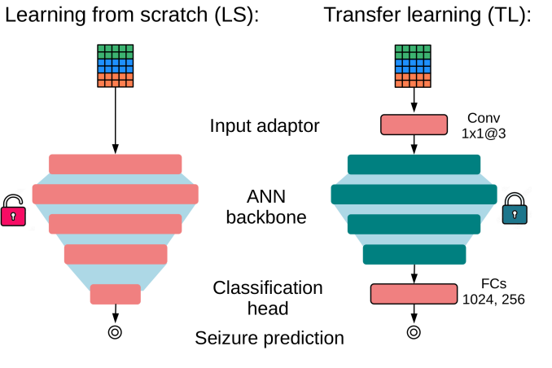
What is Transfer Learning
What is Transfer Learning?
Reusing a model pretrained on a large dataset
ImageNet models learn general features such as edges and patterns
H. Yang and R. Tetzlaff, "Epileptic seizure prediction: Transfer learning with compact AI models," in 2025 IEEE 7th International Conference on Artificial Intelligence Circuits and Systems (AICAS), 2025, doi: 10.1109/AICAS64808.2025.11173126.

Slide 4
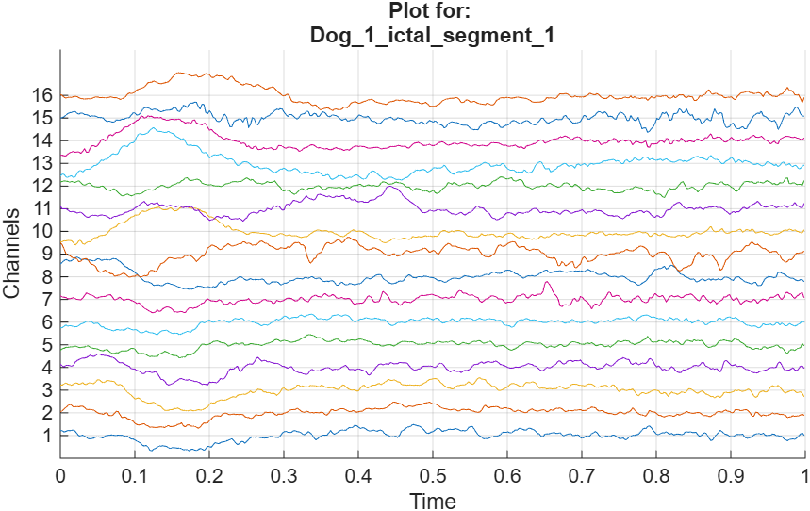
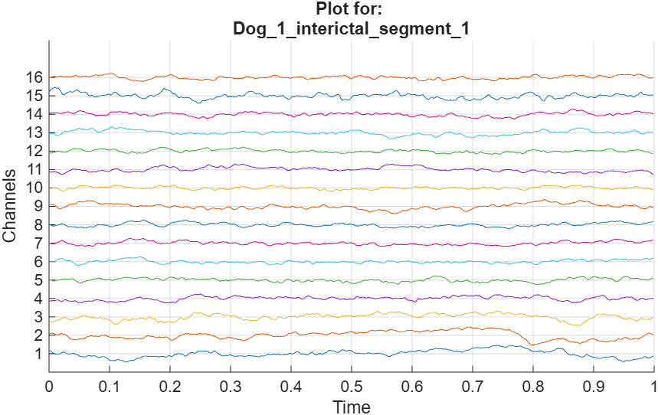
Dataset Overview
EEG Dataset
EEG recordings from dogs
Two classes: seizure (ictal) and non-seizure (interictal)
1-second clips, 16 channels, 400 Hz sampling rate
Challenges
Limited dataset size
Strong class imbalance
High temporal dependency

Slide 5
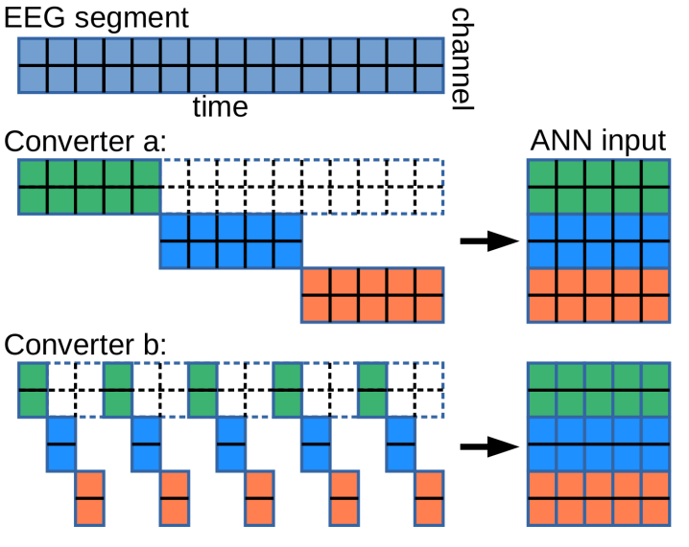
EEG Data to Image Conversion Methods
Converter A
Simple temporal down-sampling
Limited temporal information
Converter B
Temporal shifting and stacking
Richer temporal representation
FFT Conversion
Converting the time-domain data to frequency-domain
Possibility to extract more information from the data
H. Yang and R. Tetzlaff, "Epileptic seizure prediction: Transfer learning with compact AI models," in 2025 IEEE 7th International Conference on Artificial Intelligence Circuits and Systems (AICAS), 2025, doi: 10.1109/AICAS64808.2025.11173126.

Slide 6
Results – Performance Comparison of ShuffleNet
Accuracy
Converter B | 0.67
Converter A | 0.7292
Frozen Backbone | 0.8542
Classification Head | 0.875
Unfrozen Backbone | 0.8542
Scratch | 0.7083
FFT Converter | 0.9357

Slide 7
Conclusion
Results of the study
The results affirm our suspicion that transfer learning is advantageous over training models from scratch when it comes to limited datasets
Interpretation
The results of transfer learning can be further enhanced by using different data conversion methods.

